Slide 1
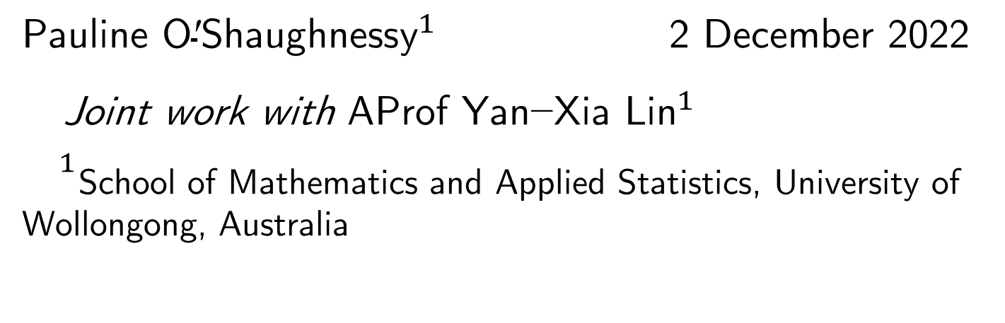
Enabling Statistical Analysis Without Disclosing Data Values
${\text{Pauline} \text{O}\text{′}\text{Shaughnessy}}^{1}$ 2 December 2022
Joint work with A$\text{Prof} \text{Y}{\text{an}\text{−}\text{Xia} \text{Lin}}^{1}$
${}^{1}$School of Mathematics and Applied Statistics, University of Wollongong, Australia
Notes:
Pauline-from university of Wollongong, Australia.
Today we like to talk about a data privacy related topic on how can we use existing data clustering tool to when the true data values are not available.
Joint work;
it is an area only starting to receive attention lately
In Wollongong, we have a small team of 2, sometimes 3 depends on the season. We are often joke that we are the data privacy expert in Australia

Slide 2
Overview of Data Privacy
Data privacy has been studied separately in the area of Statistics (Statistical disclosure) and Computer Science (privacy-preserving data mining and privacy enhancing technologies).
Torra and Navarro-Arribas (2016) categorized these methods based on the types of data and the uses of data:
When specified analyses are to be preformed, the privacy protection is much focused on securing record identification from dataset query => differential privacy
Privacy concerns is on the protection of the outcomes of the algorithm, not data itself => privacy-preserving data mining
In general cases in which data is published for general use => data masking (Statistics) or anonymization algorithms (Computer Science)
Torra and Navarro-Arribas (2016) Big Data Privacy and Anonymization. doi:10.1007/978-3-319-55783-0_2
Notes:
Because of the audience here, I will first give a brief overview of data privacy.
Due to its nature, data privacy gaining attention with the uprising of the big data. Much work has been done in computer science, but not in statistics. Data privacy in Computer Science has gain much more attention and more extensively developed. Despite the technical problem, perhaps the biggest challenge is to be recognized each other’s work over quite different fields.
Literature on talk about two fields together Torra and his colleague; to truly tell we are quite covering different fields of work.

Slide 3
Overview of Data Masking Process
Masking methods (anonymization) transform dataset systematically prior to the release of the data.
3 categories of data masking methods:
Data generalization and suppression: makes data less detailed.
Perturbative: alter data values by introducing pre-determined errors, e.g., noise addition and multiplication, substitution, rank swapping.
Synthetic data generator: replace original data with values generated from a model.
Unknown to the public
(i) Data Masking Process
(data providers)
Original Data
Masked Data
(ii) Statistical Information
Retrieval (data users)
Notes:
Perturbative: change face value of the data
Data generalization (summary) or
suppression (most mostly used when realising a subset of data; supress records of individuals who can be easily identified dur to their unique characteristics): but one might argue that with closer link with principle of differential privacy.
A lot of literature existed in the data making process
Another aspect of the statistical disclosure control is Statistical information retrieval: this is part really makes stand differently from computer science (differential privacy)
It makes sense statistical point of view: Think about statistical inference, in most statistical analysis, we are more interested in the parameters estimation from the data, not the data itself. Parameter estimates is the results we used for report.
If I am a data user and I got the noise-altered data, I will not be confident with the result if I plug in these marked data and analys them directly.

Slide 4
Analysing Masked Data
How to do data analysis on the masked data?
Ideas:
All institutions mask their data before publishing.
Users reconstruct density function of the original data using the masked data.
Generate synthetic data from the reconstructed density model.
Perform analysis on synthetic data.
Notes:
Use the clustering analysis as a example
Data may contain sensitive or commericial values
Assume data form two cluster mean
As we discuss before, each institute will do the data masking separately. Usually they are required to use the same masking method.
It is build upon the likelihood principle, which arguably is the greatest contribution of fisher, which says that all the evidence in a sample relevant to model parameters is contained in the likelihood function.
What we want is a good density function close enough to the original one
Not the data itself
i.e., ultimately we want the statistical information about the data, not data itself.
all data are generated from a underlying probability distribution, and the data we see just a snapshot of what it can be. And statistical inference is built up the underlying distribution, not the merely on the data itself, i.e., as long as we can correct the underlying distribution or close to it, inference will correct.
Data clustering either using K mean or mixture EM algorithm
Fisher’s likelihood principle :all the evidence in a sample relevant to model parameters is contained in the likelihood function.

Slide 5
Sample Size
Q: What is the minimum number of size of a sample drawn from a mixture distribution if we wish the sample can demonstrate the statistical information of the clusters of the population?

Slide 6
GOAL: The clustering analysis outputs given by the simulated data is close to the inference from the original data.
whether the reconstructed density function is close to the density function determined by the original data
the size of the simulated data
It depends on:
M=500 samples
M=1000 samples
Underlying density function
Smooth density function from simulated data
Notes:
Reconstructed density function:
For additive noise: some existing literature: Lin and Krivitsky (2018) use iterative algorithm using Bayes theorem, and using EM algorithm. A method use a spectral filtering technique cased on the random matrix, works less well.
For noise multiplicative, a moment based density approximation is developed by Lin (2014). This is a better method when it comes to evaluate higher order moment, which is mathematically difficulty to do for additive noise.
another can of worm: not focused in this talk
Size of simulated data: less obvious problem
We use constructed density function of the original data to simulate a set of synthetic data, but we can not guarantee when we reconstruct the density function it will be close enough to the density function of the original data. We need a much smoothed density function to well capture the original data
Constructed density a smoothed function. To capture the features of the density, we need sample to be large enough.
Example: bi-modal distribution

Slide 7
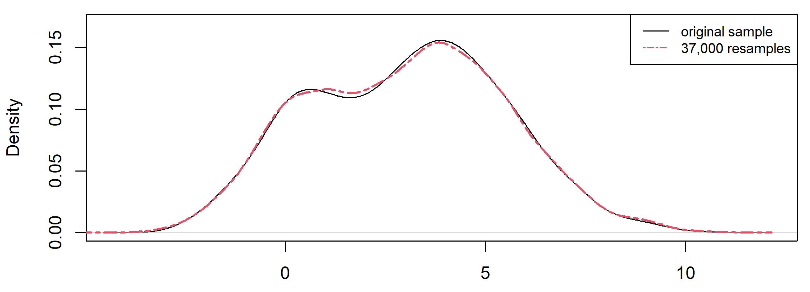
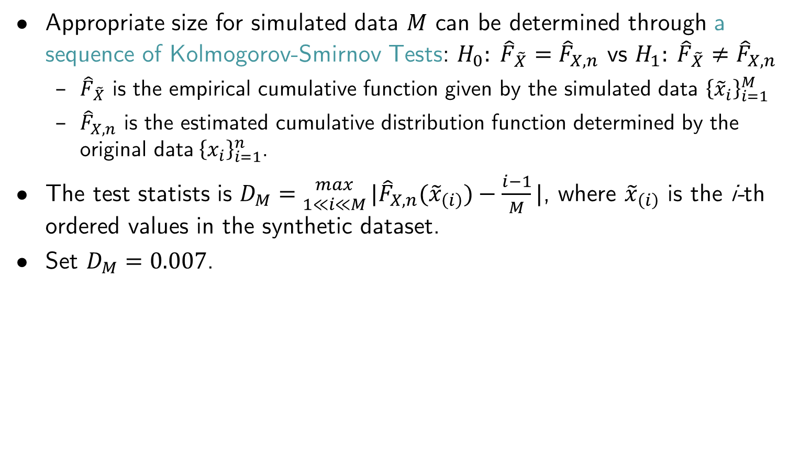
Sample Size Calculation
Appropriate size for simulated data $M$ can be determined through a sequence of Kolmogorov-Smirnov Tests: $H_{0}: {\hat{F}}_{\tilde{X}}={\hat{F}}_{X,n}$ vs $H_{1}: {\hat{F}}_{\tilde{X}}≠{\hat{F}}_{X,n}$
${\hat{F}}_{\tilde{X}}$ is the empirical cumulative function given by the simulated data ${\left\{{\tilde{x}}_{i}\right\}}_{i=1}^{M}$
${\hat{F}}_{X,n}$ is the estimated cumulative distribution function determined by the original data${ \left\{x_{i}\right\}}_{i=1}^{n}$.
The test statists is $D_{M}={max \atop 1≪i≪M}|{\hat{F}}_{X,n}({\tilde{x}}_{\left(i\right)})−\frac{i−1}{M}|$, where ${\tilde{x}}_{\left(i\right)}$ is the i-th ordered values in the synthetic dataset.
Set $D_{M}=0.007$.
Notes:
Because we only know the sample, we will determine the appropriate data size analytically, using Kolmogorov-Smirnov test
Both empirical cdf because we only know our sample, not the true population distribution

Slide 8
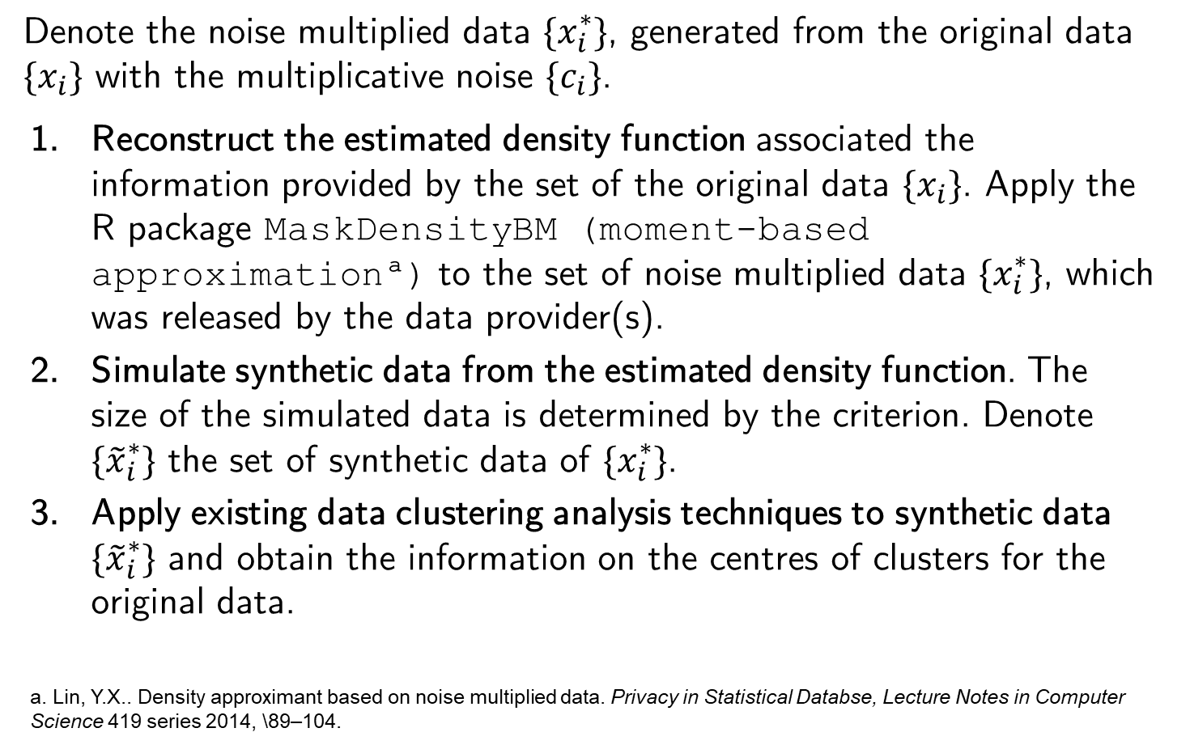
Algorithm for Clustering using Masked Data
Denote the noise multiplied data $\{x_{i}^{∗}\}$, generated from the original data $\{x_{i}\}$ with the multiplicative noise $\{c_{i}\}$.
Reconstruct the estimated density function associated the information provided by the set of the original data $\{x_{i}\}$. Apply the R package MaskDensityBM (moment-based approximationª) to the set of noise multiplied data $\{x_{i}^{∗}\}$, which was released by the data provider(s).
Simulate synthetic data from the estimated density function. The size of the simulated data is determined by the criterion. Denote $\{{\tilde{x}}_{i}^{∗}\}$ the set of synthetic data of $\{x_{i}^{∗}\}$.
Apply existing data clustering analysis techniques to synthetic data $\{{\tilde{x}}_{i}^{∗}\}$ and obtain the information on the centres of clusters for the original data.
a. Lin, Y.X.. Density approximant based on noise multiplied data. Privacy in Statistical Databse, Lecture Notes in Computer Science 419 series 2014, \89–104.

Slide 9
Case Study: Soybean Seed Size
Shorter, Byth, & Mungomery (1977). Genotype environment interactions and environmental adaptation. ii. Australian Journal of Agricultural Research, 28 , 223-235.

Slide 10


Seed size from 58 genotypes of soybeans, 43 lines from Australia, 15 lines from other countries (12 from US)
Data is contributed by 8 companies ($58×8=464$ data points).
Step 1: Data masking performed by each company : Multiplicative raw data with noise $C$ with probability density
$$f_{C}=0.6Uni\left(2,5\right)+0.4Uni(4,6)$$
Step 2: Analysis Procedure:
Reconstruct density function and generate synthetic data ($M=1856$)
Perform cluster analysis on synthetic data, choose $k=2$ and $k=3$.
smooth density function from original data
Smooth density function from simulated data
Notes:
Not the best estimation job
Graph shows two groups, but scientifically it should be 3, => fit both k =2 and 3

Slide 11
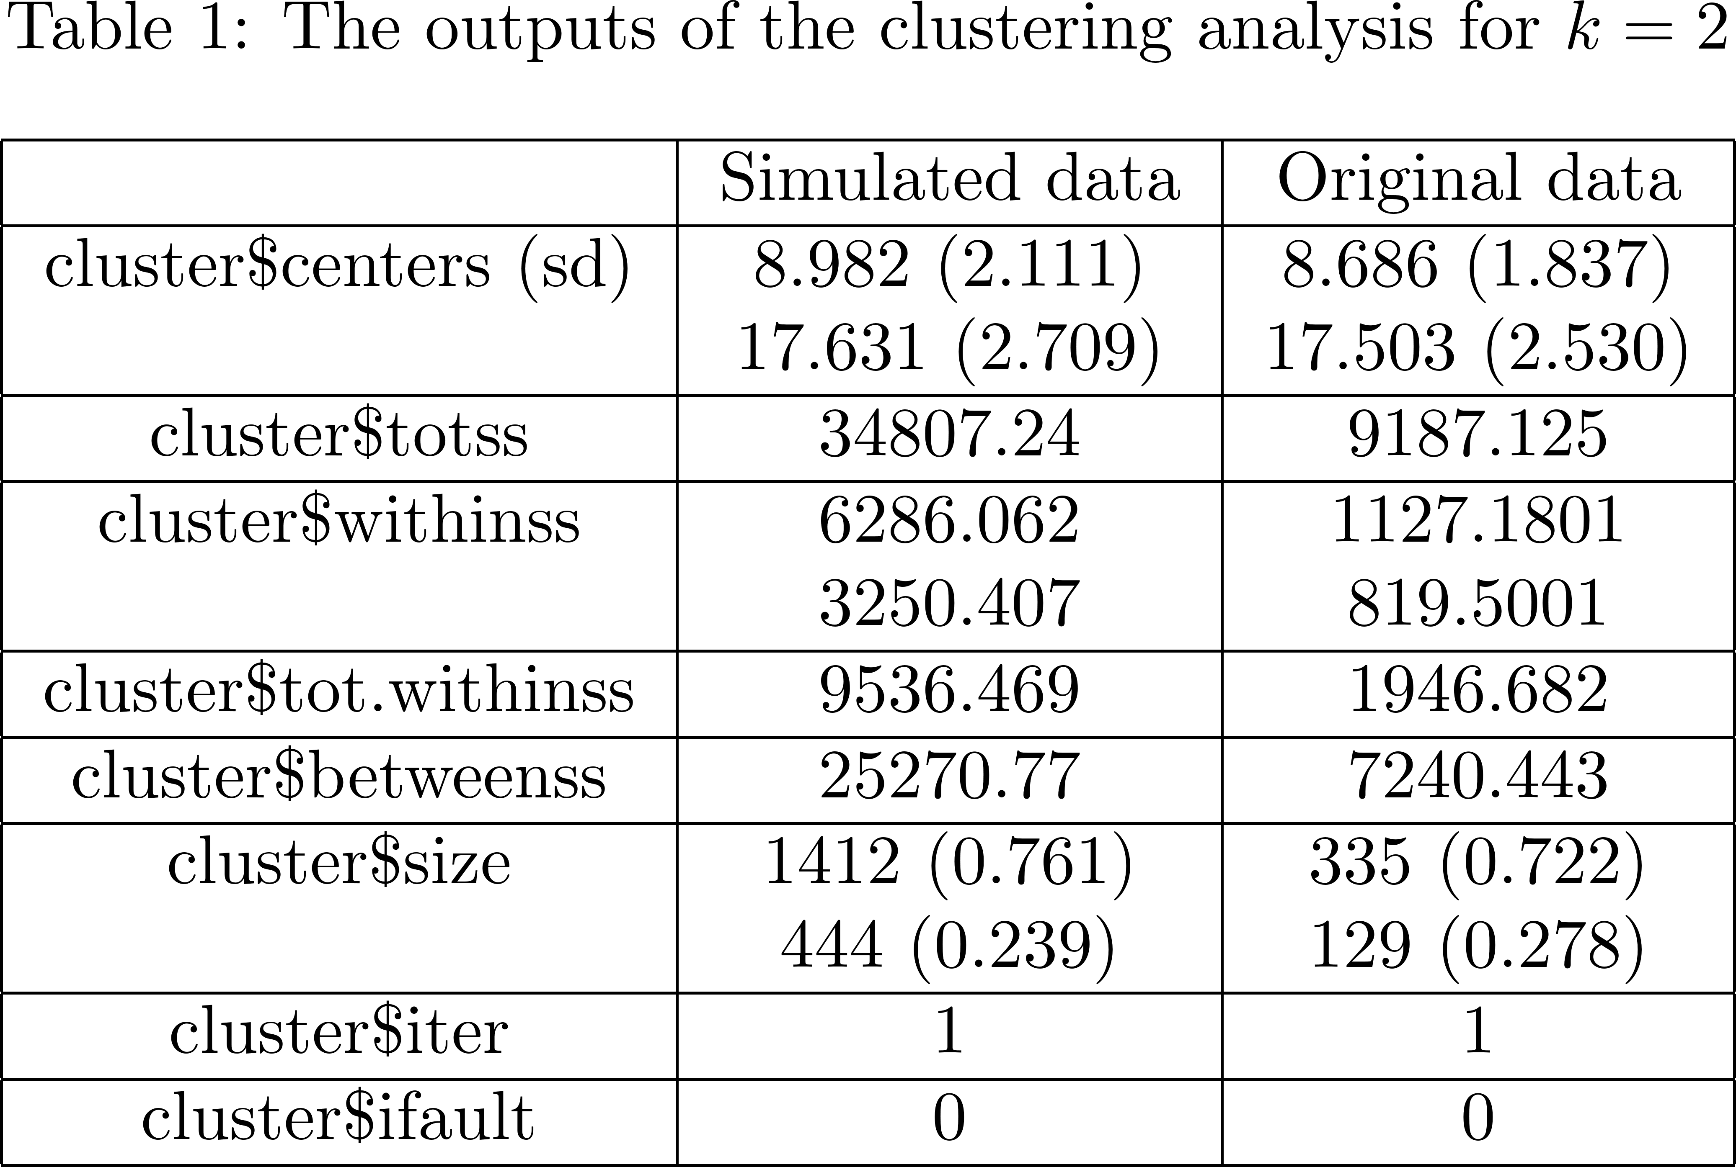
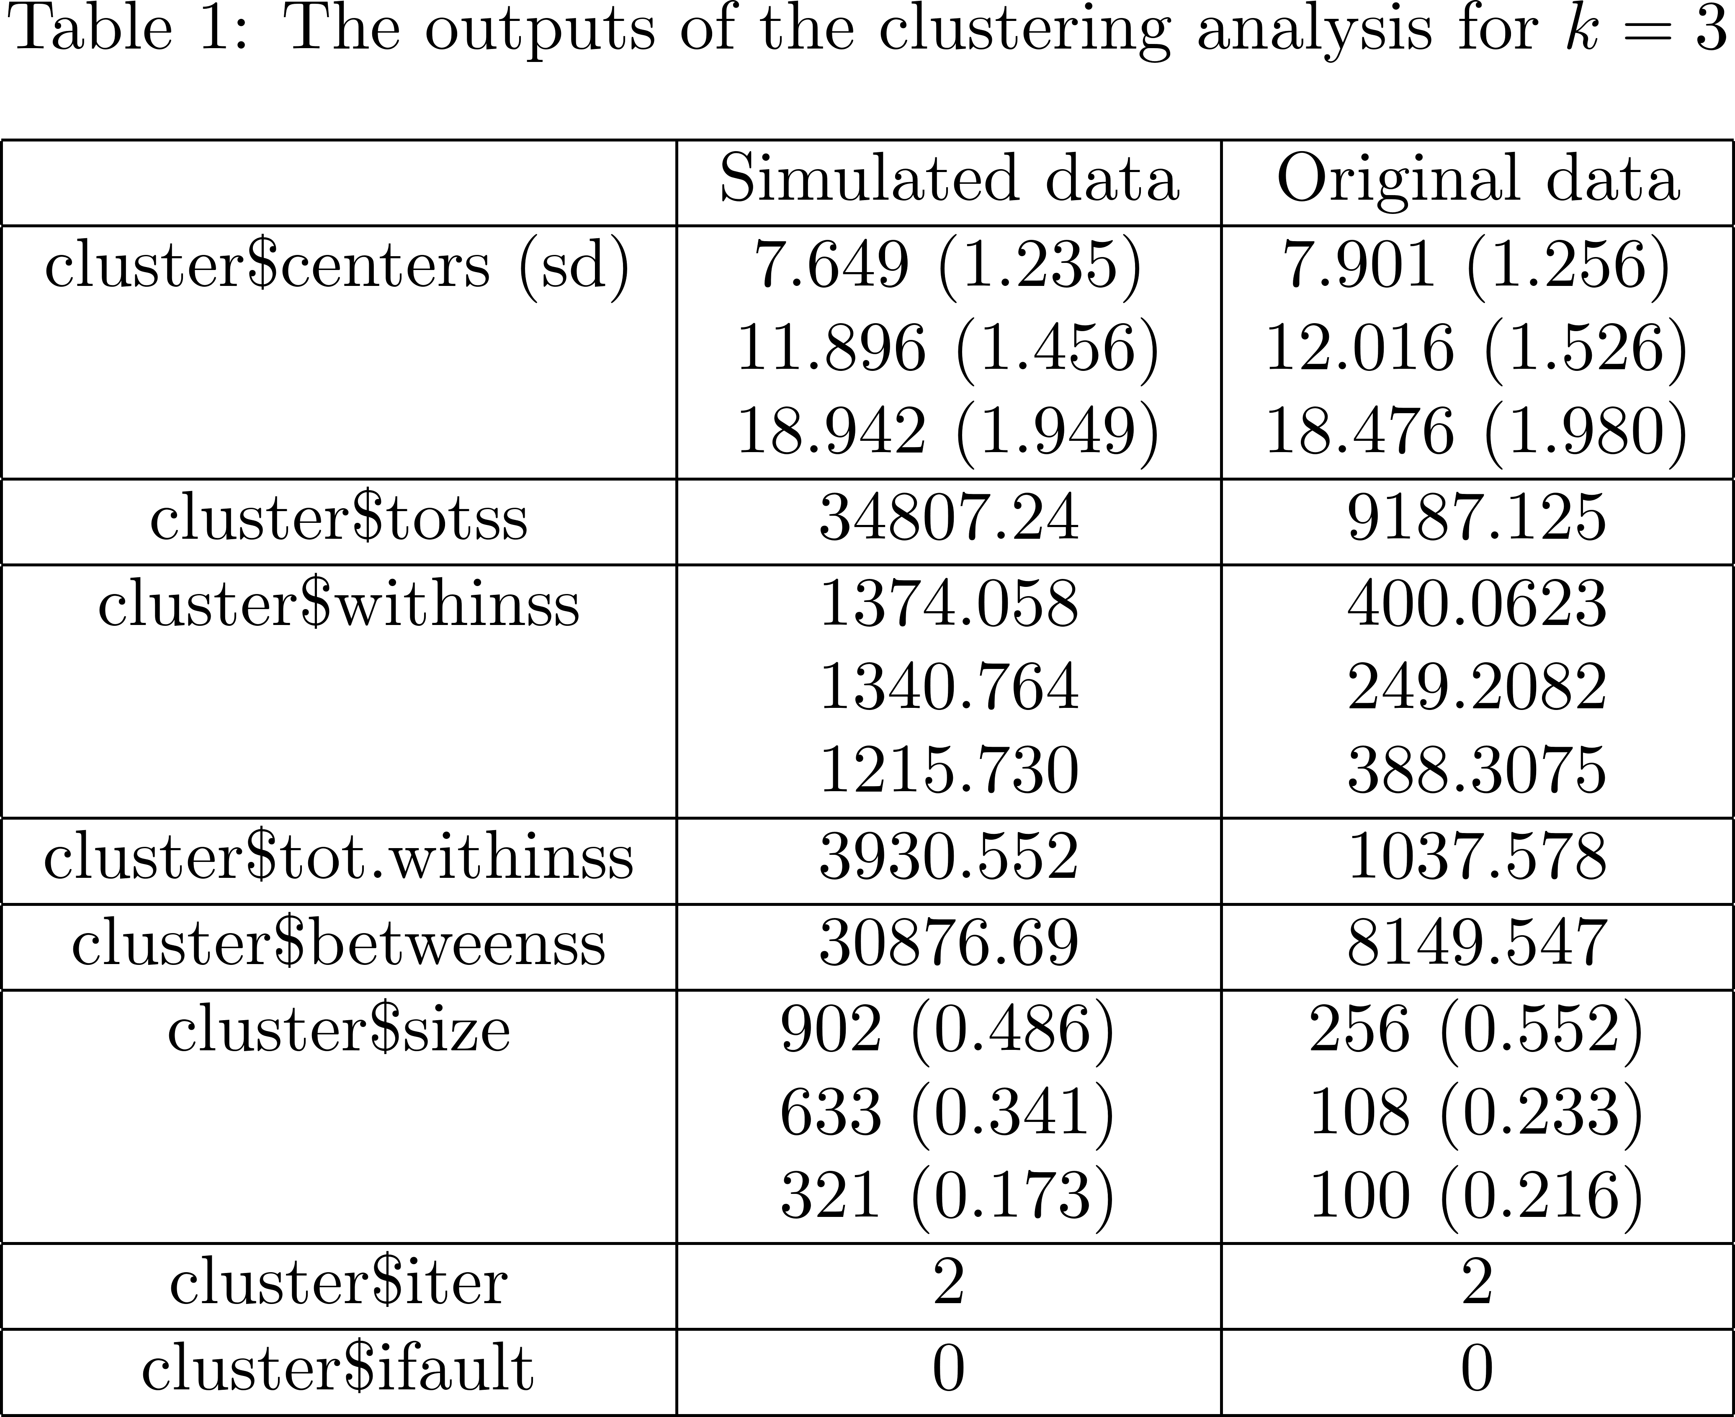
Cluster Analysis Results
Simulated data captures the cluster means similar to the original data.
Group allocation in simulated data is reasonably representative to the original data grouping.

Slide 12
Closing Remarks
Vision: Using standard statistical methods to analyse publicly-available masked data.
A newly-proposed protocol allowing applying existing data mining technique to noise-multiplicative data.
Able to generalized to other data mining techniques.
Propose a sample size calculation for density estimation.
Future works:
Density estimation/approximation methods
What if we need the synthetic sample size same as the original data
Generalization to multivariate
Threshold selection for sample size calculation

Slide 13
Thank you! ☺
Contact: poshaugh@uow.edu.au

